Slide 1
Online Cloud
By Kment Dominik,
Körner Hendrik
and Wöhrer Reinhard

Slide 2
Project Description
Online Storage on an Raspbery Pi
Website with online access
Database for User Administartion

Slide 3
Raspberry Pi
Raspberry PI 3 Model B
Quad Core 1.2GHz 64bit CPU
BCM43438 wireless LAN and Bluetooth Low Energy (BLE) on board
1GB RAM
32 GB SIM card

Slide 4
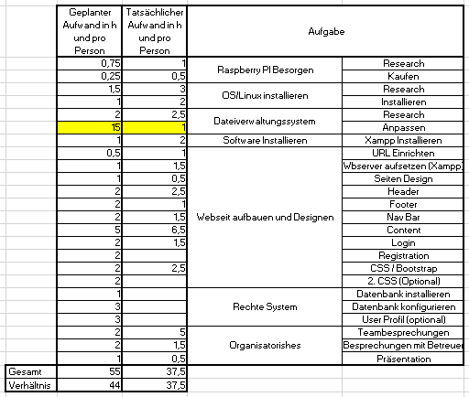
Time Estimation

Slide 5
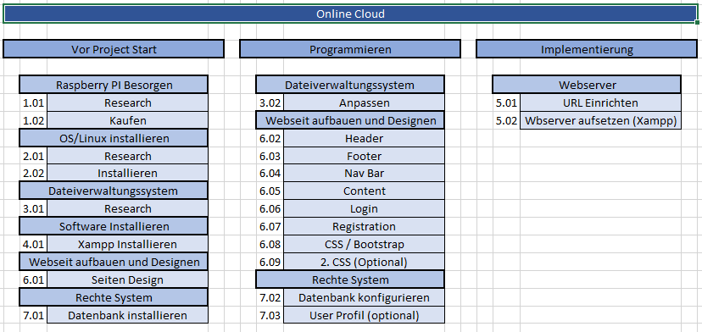
PSP

Slide 6
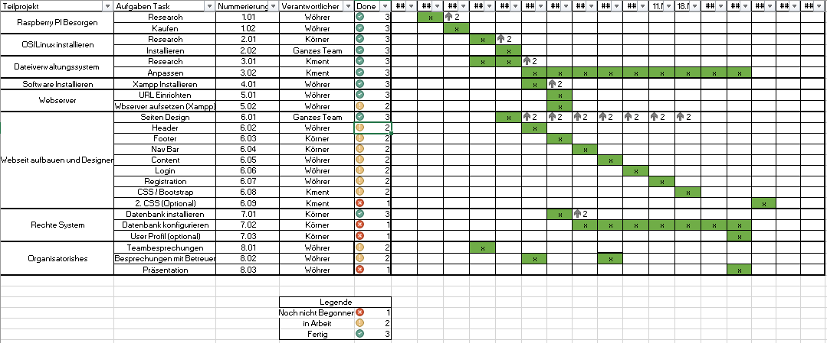
PAP

Slide 7
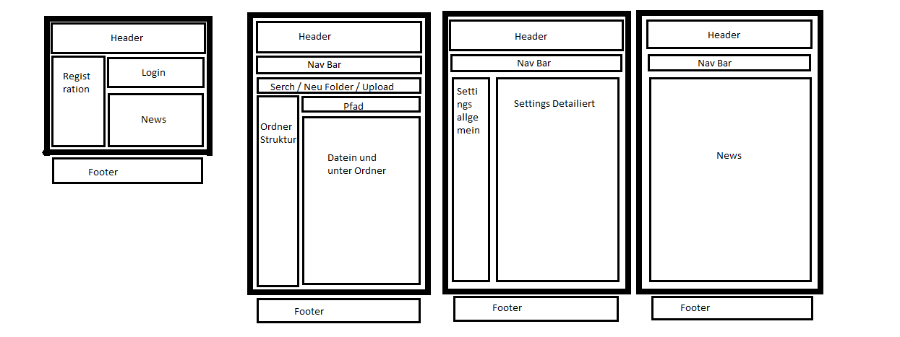
Website Design

Slide 8
Lessons Learned
Linux is Hard to Learn but Easy to use
Start with the Project as soon as possible
Don‘t be lazy

Slide 9
Live Demo

Slide 10
Thanks for your Attention

